Slide 1
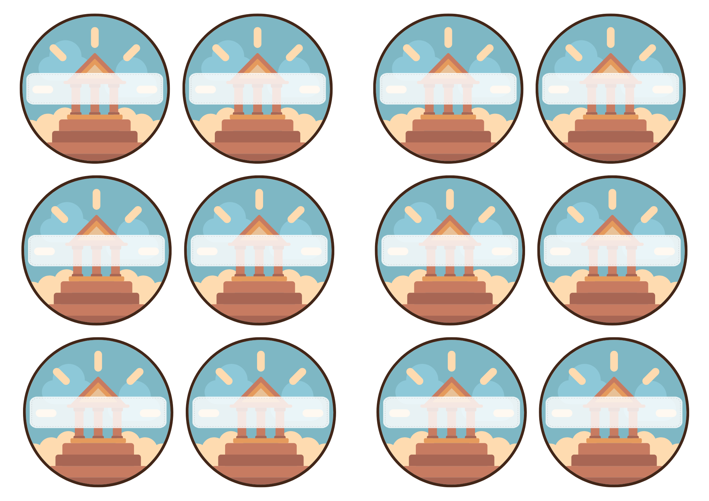
Juliette
Bana
Ilhan
Nael
Marwa
Chaili-Mia
Hugo-Joao
Tristan
Solal
Beshoy
Massimo
Manuella

Slide 2
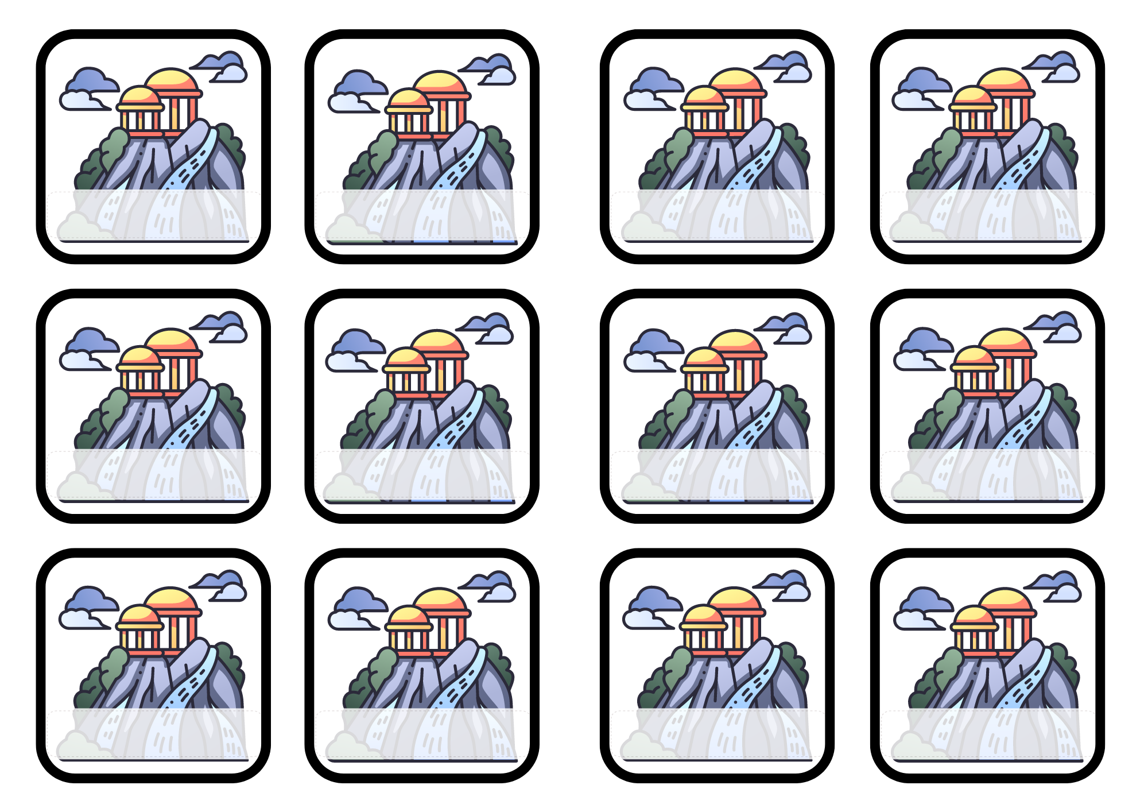
Marwa
Chaili-Mia
Hugo-Joao
Tristan
Juliette
Bana
Ilhan
Nael
Solal
Beshoy
Massimo
Manuella

Slide 3
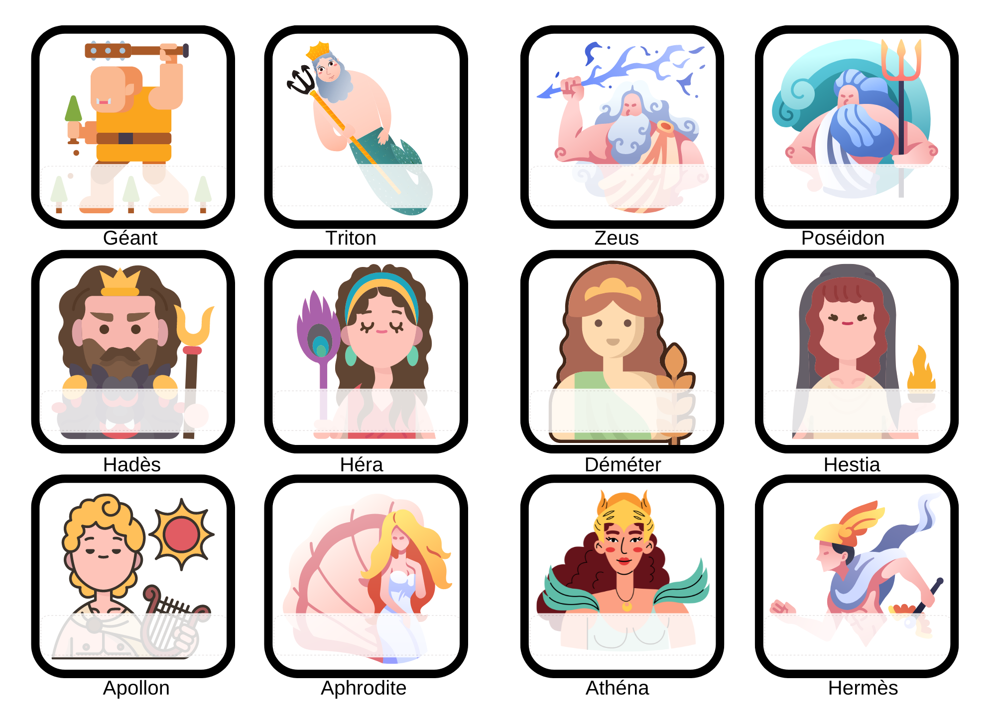
Arthur
Maxime
Hugo-Joao
Tristan
Ilhan
Bana
Marwa
Juliette
Solal
Marwa
Manuella
Massimo

Slide 4
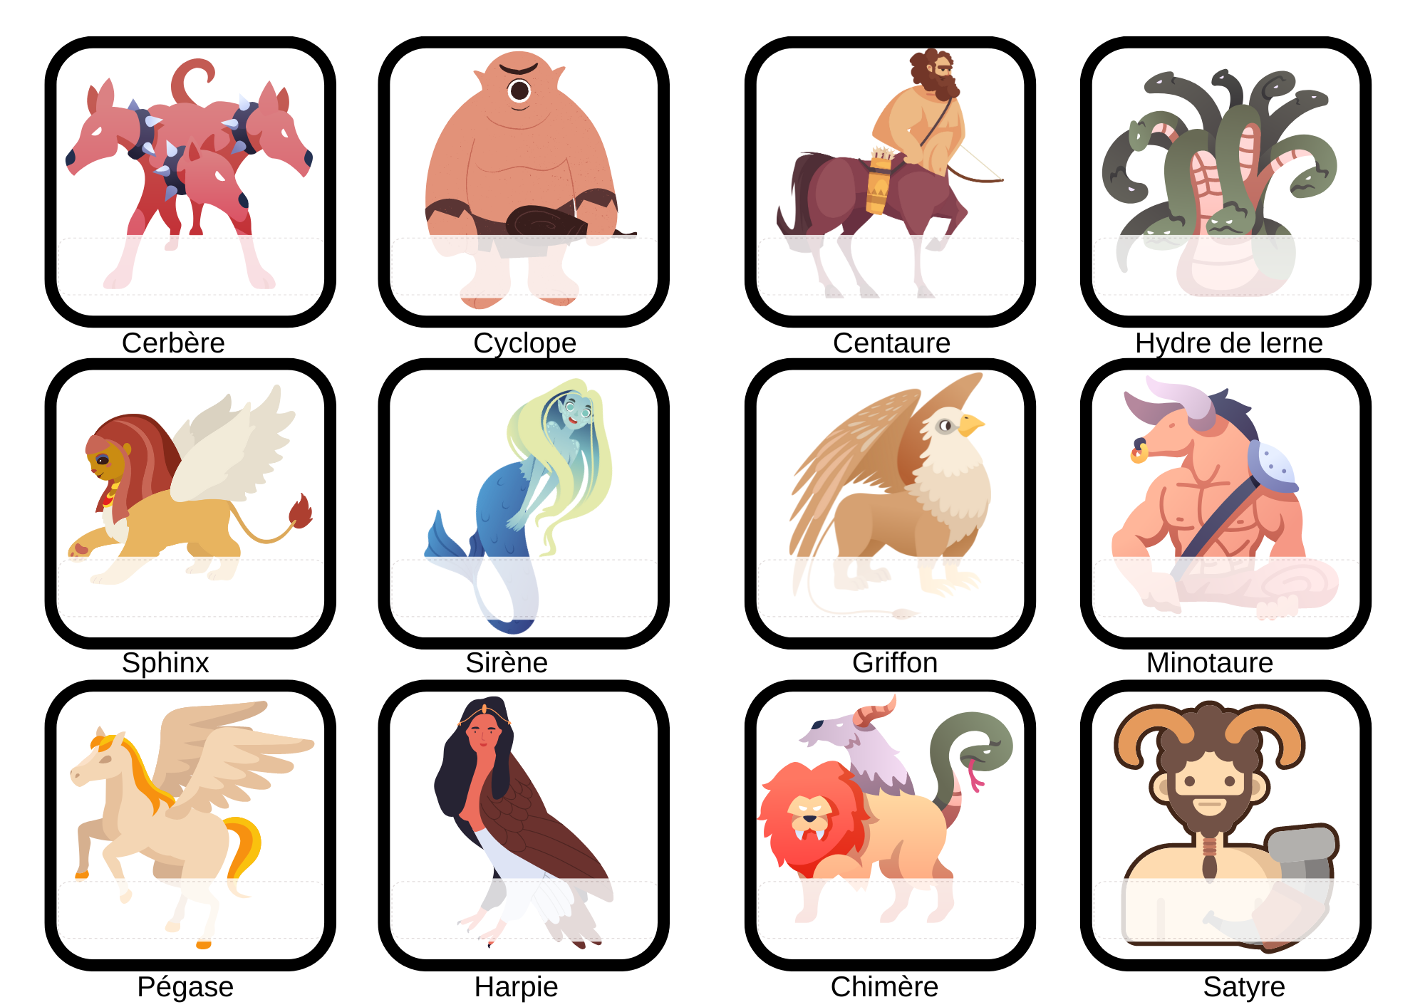
Arthur
Maxime
Hugo-Joao
Tristan
Ilhan
Bana
Chaili-Mia
Juliette
Solal
Marwa
Manuella
Massimo

Slide 5
Arthur
Louise
Hugo-Joao
Tristan
Ilhan
Bana
Maxime
Juliette
Solal
Marwa
Manuella
Massimo

Slide 6
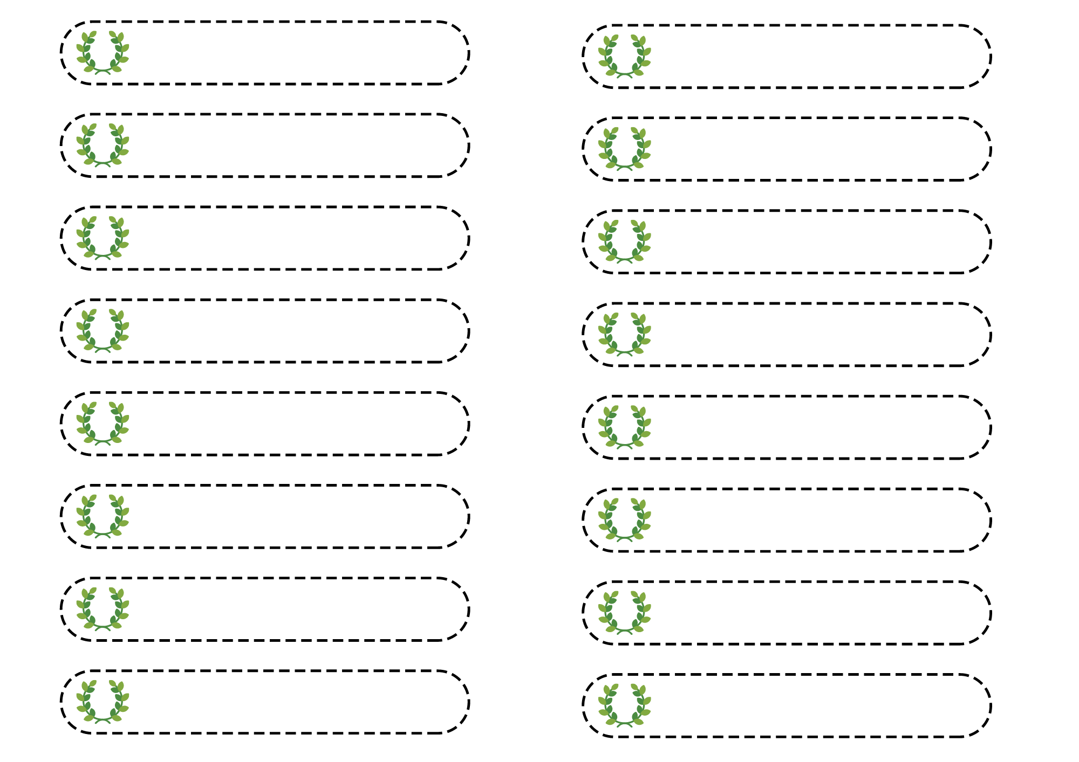
Arthur
Juliette
Massimo
Bana
Maxime
Manuella
Tristan
Louise
Beshoy
Marwa
Solal
Chaili-Mia
Nael
Martin
Hugo-Joao
Hadja

Slide 7
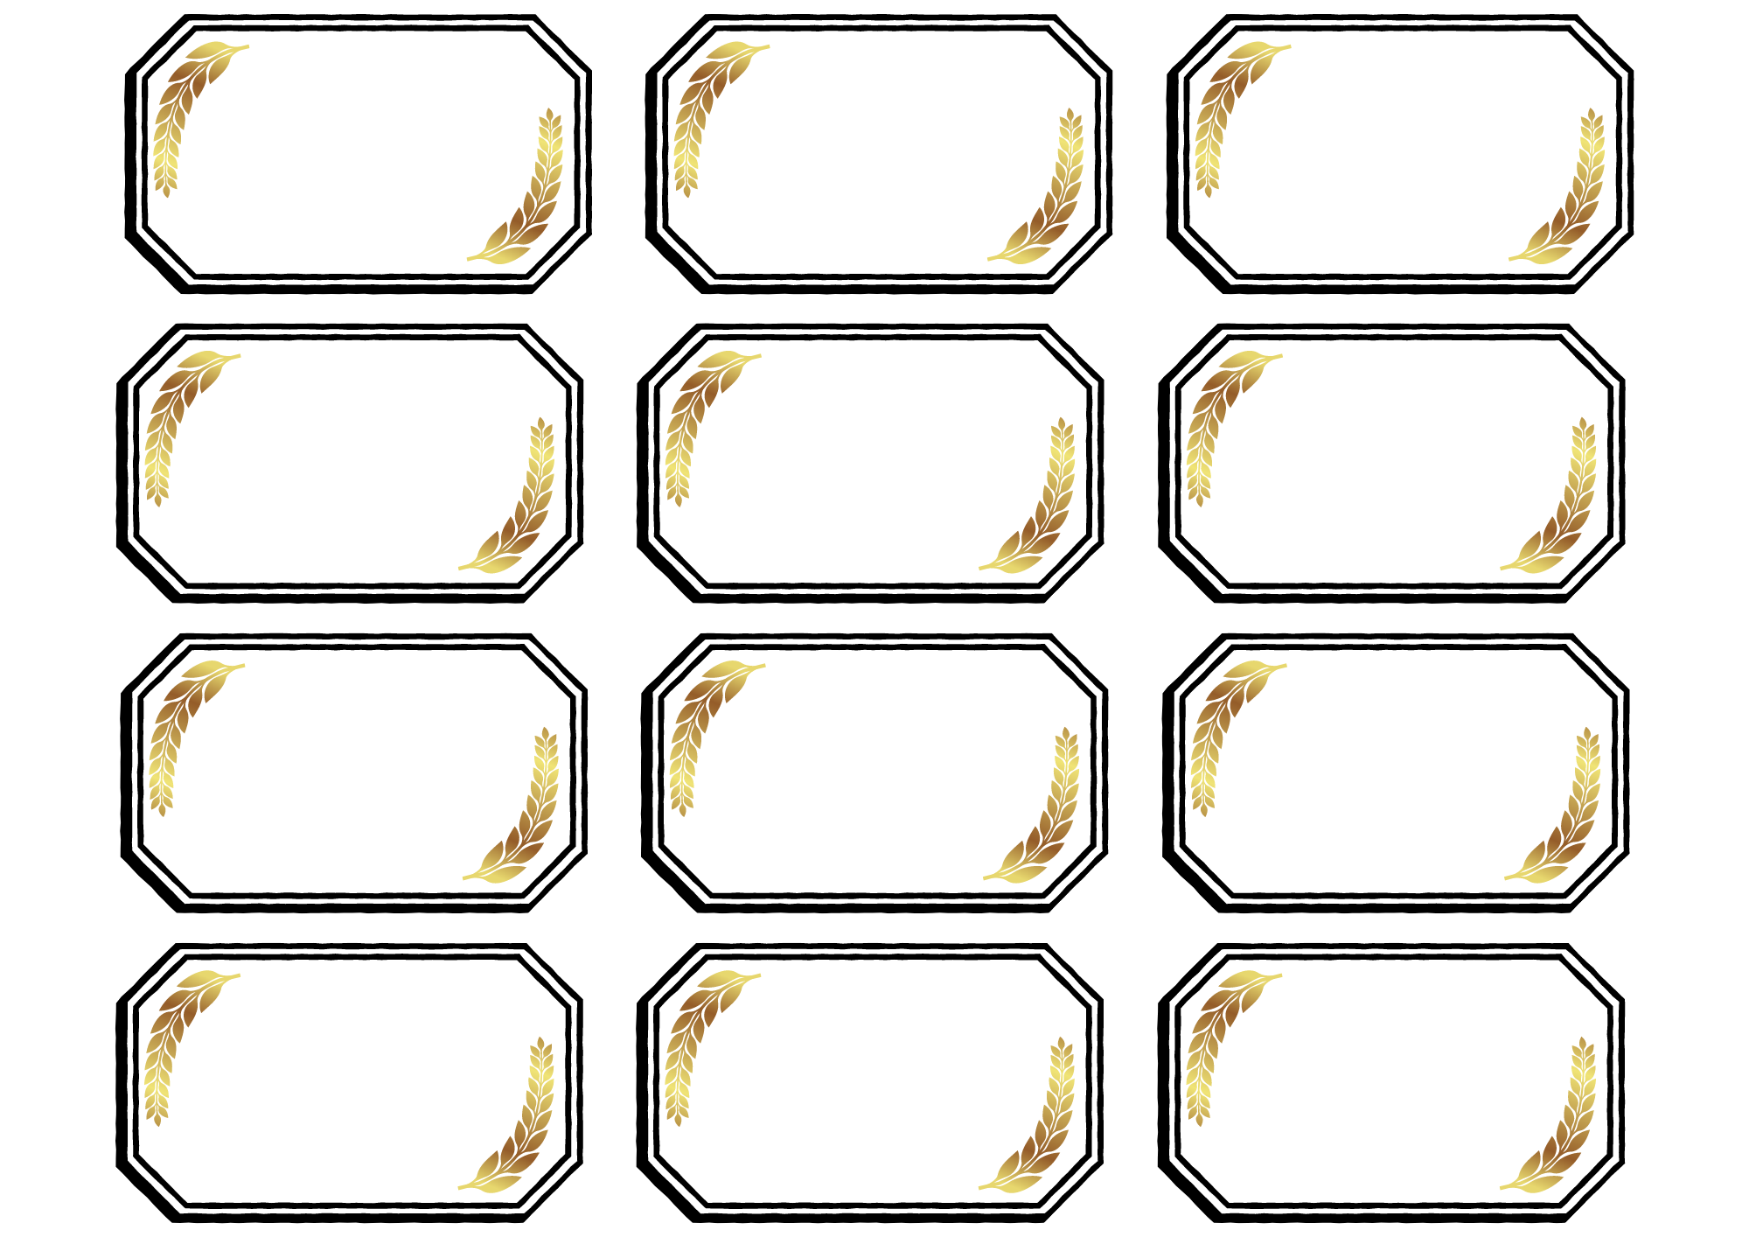
Hugo-Joao
Arthur
Tristan
Louise
Ilhan
Maxime
Bana
Juliette
Marwa
Solal
Manuella
Massimo

